Slide 1
Networking Jump Start
If you can do this, you can do anything.

Slide 2
IP ADDRESSING
The name of a computer, printer, router, switch, X-Box, etc. on a network is an IP Address.
In general, IP Addresses should represent only one computer in the world (they are unique).
The front of the IP Address identifies the business where the computer is located, and the back identifies the specific computer in that business.
There are two IP Addressing systems, IPv4 and IPv6, but we will be focusing on IPv4, as that is the best place to start.

Slide 3

IPv4 Addressing
192.168.10.22
The red numbers are the “name of the business.”
The blue number is “the specific computer.”

Slide 4
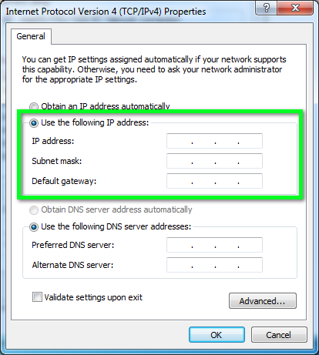
Windows Wants More Numbers!

Slide 5
We Need Three Different Numbers
192.168.10.22 – IP Address
255.255.255.0 – Subnet Mask
192.168.10.1 – Default Gateway

Slide 6
We Need Three Different Numbers
192.168.10.22 – IP Address (Our Computer)
255.255.255.0 – Subnet Mask (Business Size)
192.168.10.1 – Default Gateway (Router)

Slide 7




INTERNET

Slide 8
INTERNET
IP: 192.168.10.22
SM: 255.255.255.0
DG: 192.168.10.1

Slide 9
INTERNET
?
IP: 192.168.10.22
SM: 255.255.255.0
DG: 192.168.10.1

Slide 10
INTERNET
IP: 192.168.10.22
SM: 255.255.255.0
DG: 192.168.10.1
IP: 192.168.10.23 through
192.168.10.254

Slide 11
INTERNET
IP: 192.168.10.22
SM: 255.255.255.0
DG: 192.168.10.1
IP: 192.168.10.23
SM: 255.255.255.0
DG: 192.168.10.1

Slide 12
INTERNET
IP: 192.168.10.1
SM: 255.255.255.0
IP: 192.168.10.22
SM: 255.255.255.0
DG: 192.168.10.1
IP: 192.168.10.23
SM: 255.255.255.0
DG: 192.168.10.1

Slide 13
I am the Default Gateway!
INTERNET
IP: 192.168.10.1
SM: 255.255.255.0
IP: 192.168.10.22
SM: 255.255.255.0
DG: 192.168.10.1
IP: 192.168.10.23
SM: 255.255.255.0
DG: 192.168.10.1

Slide 14
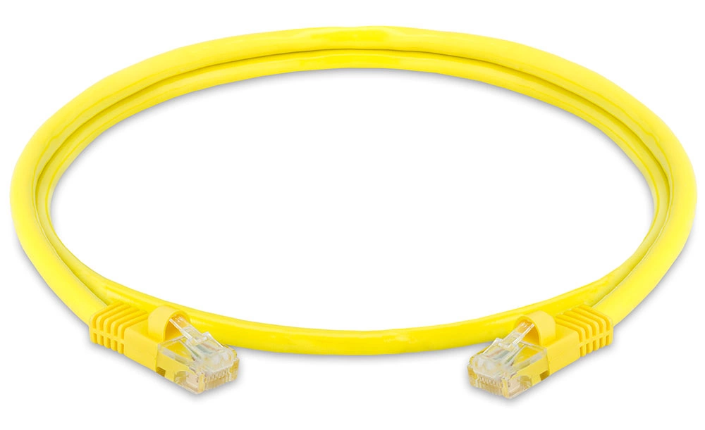
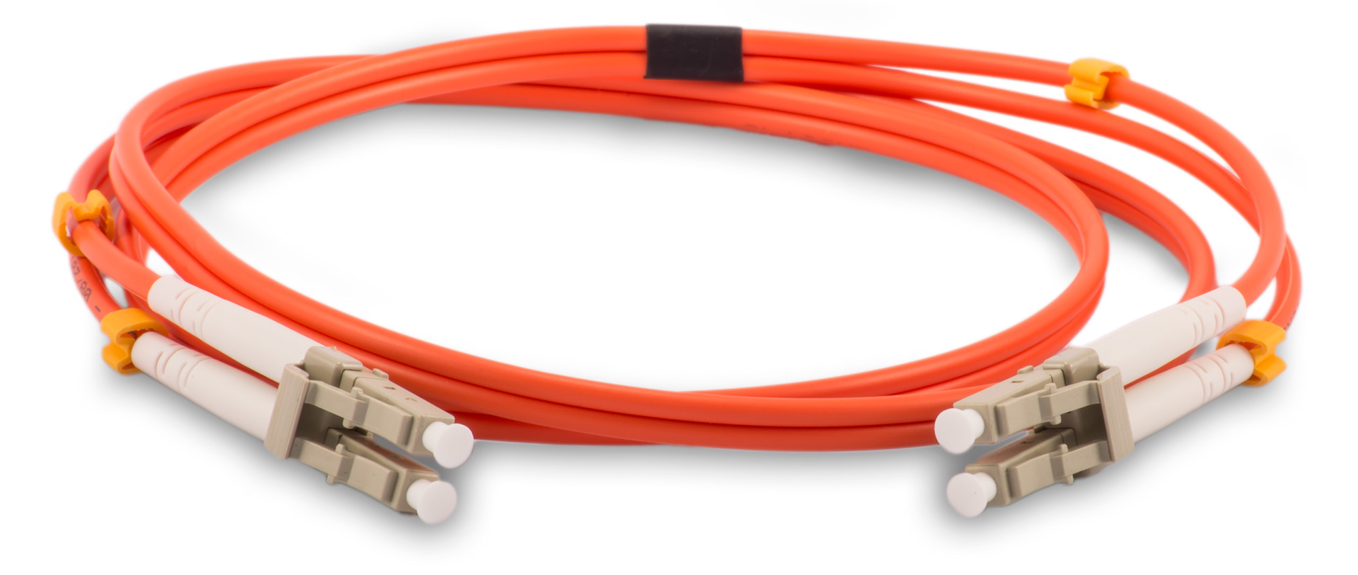
Cables!
The two main cables are copper (Cat5, Ethernet) and fiber optic.
Copper is cheap and works well enough.
Fiber is expensive and, well, expensive.

Slide 15
Equipment
NIC – Network Interface Card – Provides a way for your laptop, desktop, phone, printer, etc. to connect to the local network.
Switch – Connects multiple devices together to form the local network.
Router – Connects networks together, such as your local network to the Internet.
Firewall – Can look at traffic and say “no” to passing things along.
WAP – Shares a single switch port with multiple wireless devices.

Slide 16
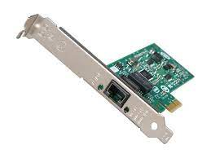
Network Interface Card

Slide 17
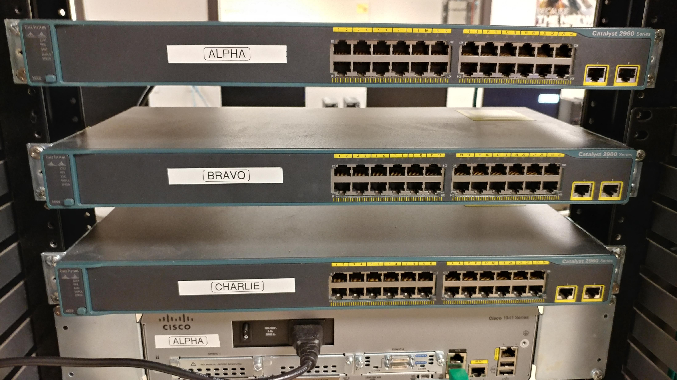
Switch

Slide 18
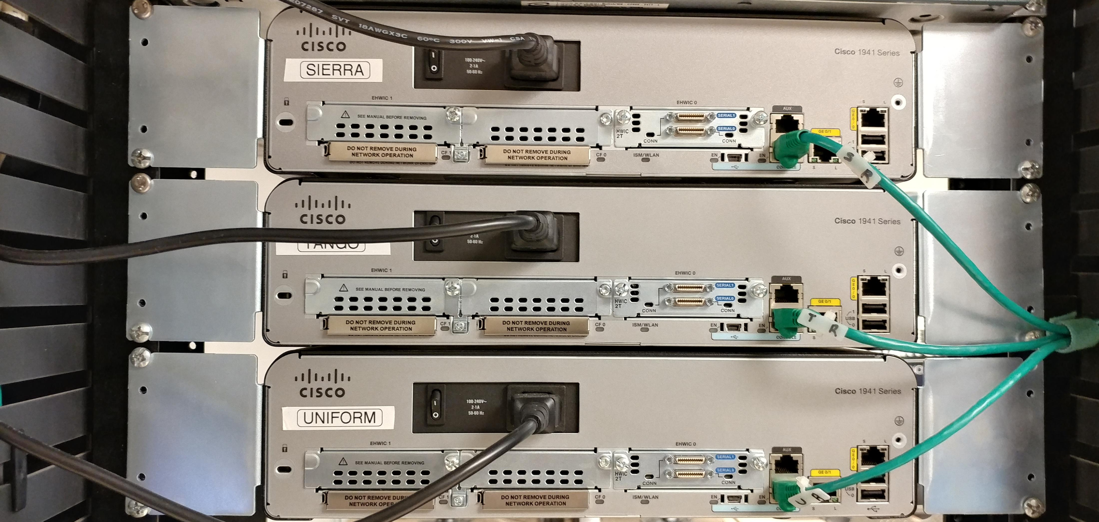
Router

Slide 19
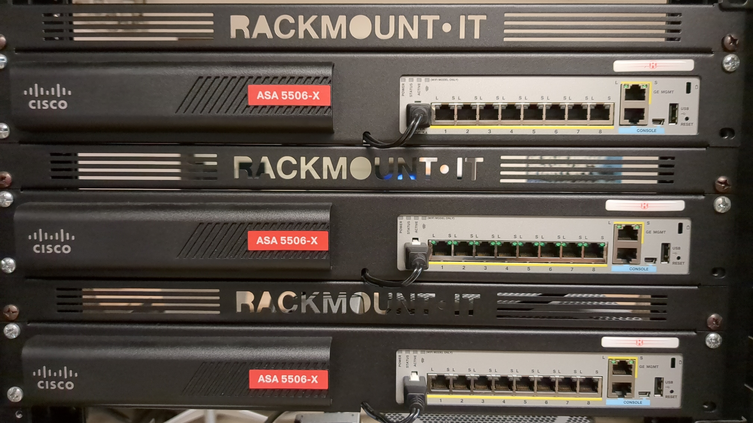
Firewall

Slide 20
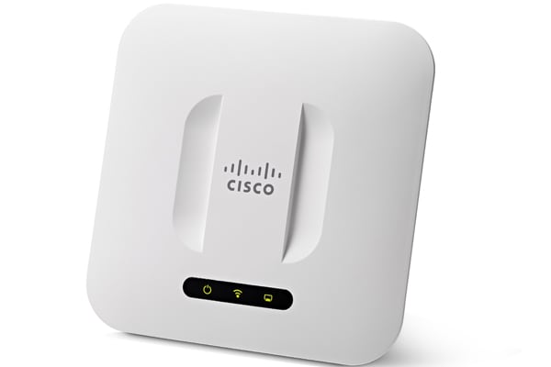
Wireless Access Point

Slide 21
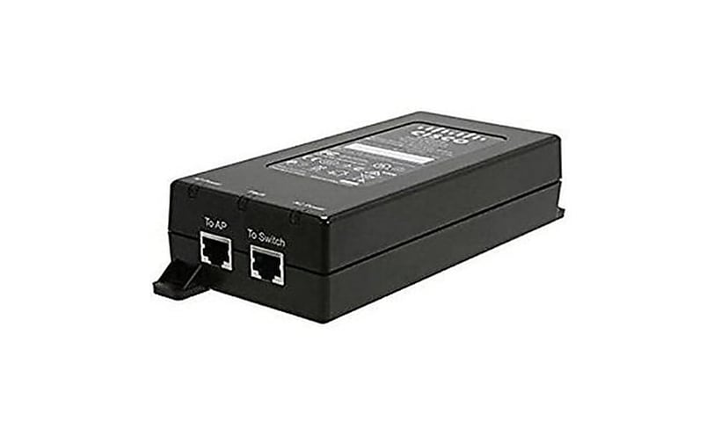
PoE Injector

Slide 22
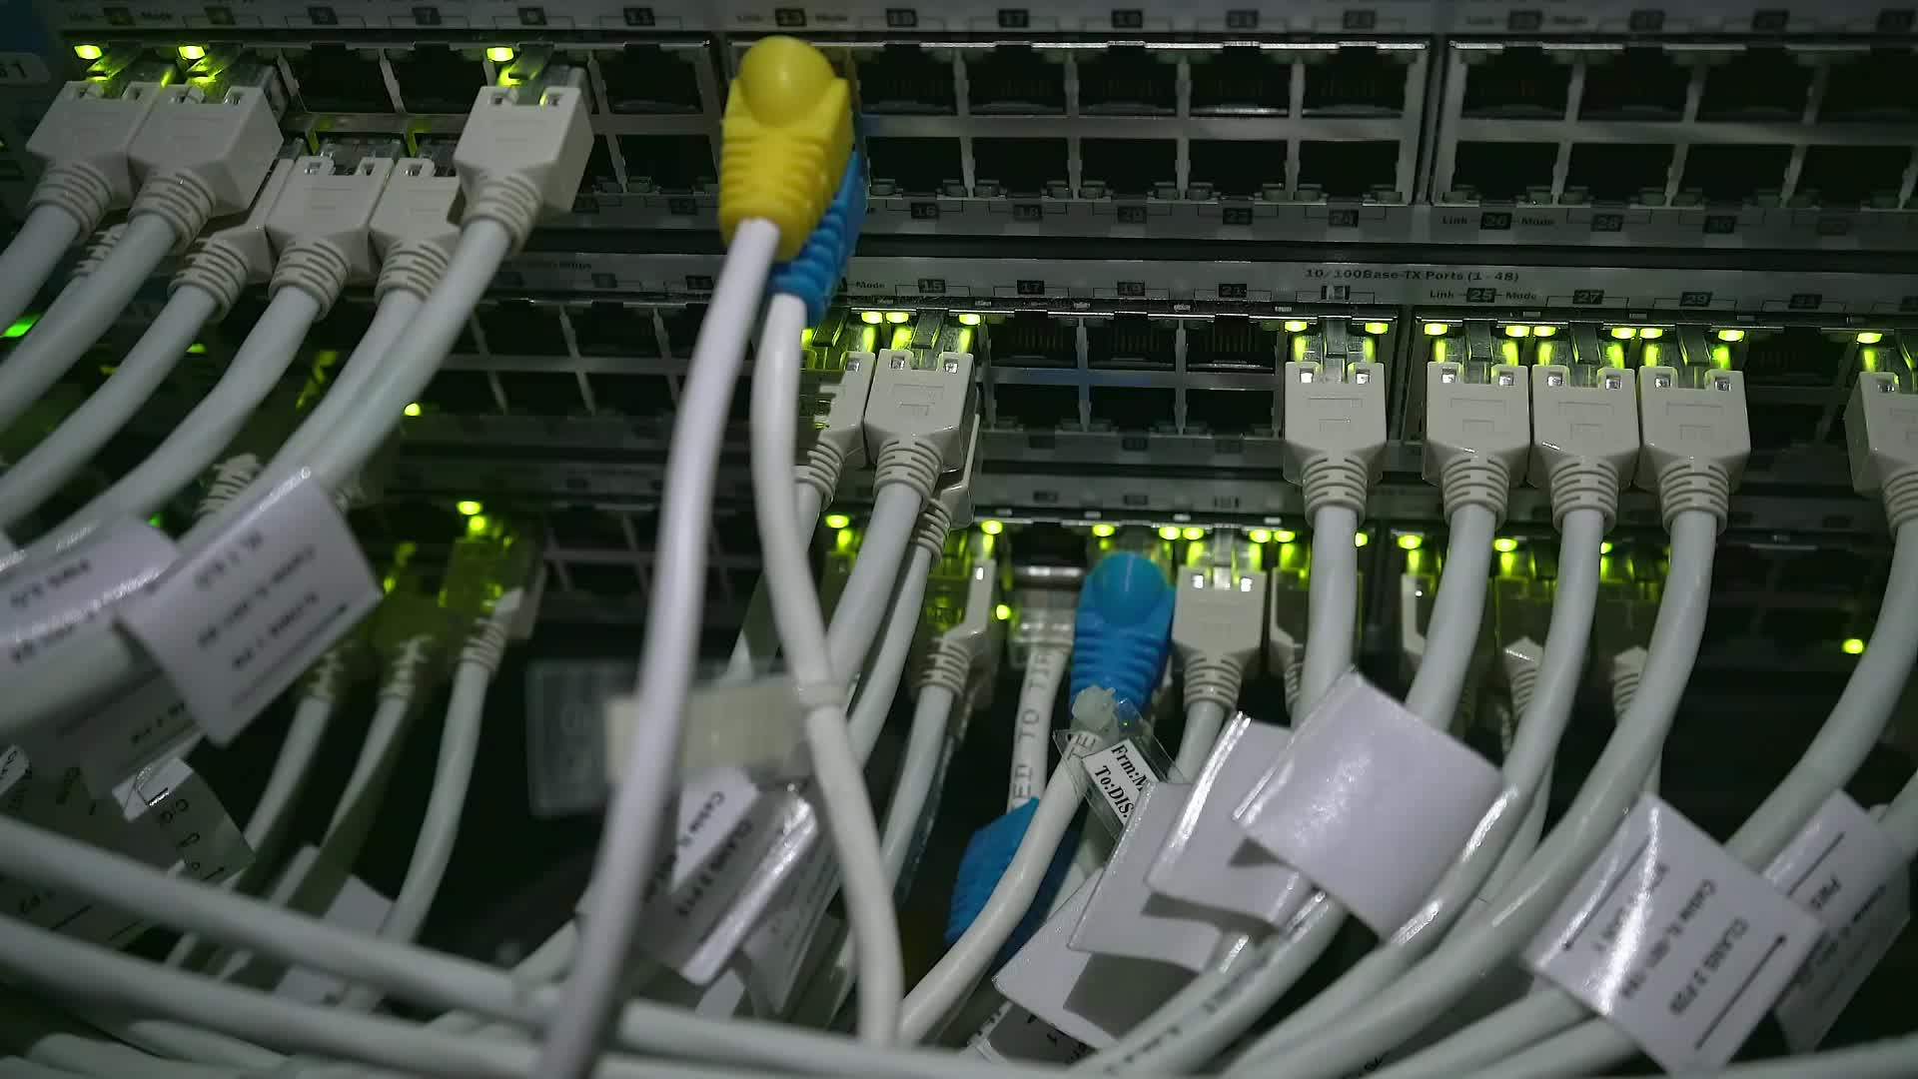
Let’s Build a Network

